Slide 1
Free Magnetic Energy and Flare Productivity of Active Regions
Jing et al.
ApJ, 2010, April 20 v713 issue, in press

Slide 2
Motivations #1
Free Magnetic Energy E_{free}
Eq. (1)
where V is the volume of computational domain.
Soft X-ray Flare Index FI
Eq. (2)
where τ is the length of time window (measured in days), and I_{X} I_{M} I_{C} and I_{B} are GOES peak intensities (in units of 10⁻⁶ W m⁻²) of X-, M-, C- and B-class flares produced by the active region for the duration τ.
In this study, we use three different time windows ranging from the time of the analyzed
magnetogram to the subsequent 1, 2 and 3 days after that time, i.e., FI _{n-day} , where n=1,2,3

Slide 3
Motivations #2
Examine the statistical correlation between free magnetic energy E_{free} and flare index FI_{n-day} measured within the 1-, 2-, and 3-day time window.
Study the temporal variation of E_{free} for both flare-active and flare-quiet regions over a period of days.

Slide 4
Data Processing
Eq. (2)
Hinode/SP data spectra
NOAA Solar Event Reports
FI_{n-day}
Stokes Inversion using an
Unno-Rachkovsky inversion based on the assumption of the Milne-Eddington atmosphere
E_{free}
Eq. (1)
Remove the 180° ambiguity with the “minimum energy” method (Metcalf 1994)
Extrapolate the NLFFF with the weighted optimization method (Wiegelmann 2004)
Extrapolate the potential field with a Green function method (Aly 1989)
Correct the projection effect for off-disk-center data
Preprocess the non-force-free photospheric vector magnetograms to remove forces and torques from the boundary (Wiegelmann et al 2006)

Slide 5
Top panels: Scatter Plots of FI _{n-day} vs. E_{free} . FI _{n-day}s which equal 0 are set to 0.01 to avoid arithmetic error and shown as grey points.
Bottom panels: Scatter plots of FI_{n-day} vs. E_{pe} ;
Result #1

Slide 6
Top panels: Scatter Plots of FI _{n-day} vs. E_{free} . FI _{n-day}s which equal 0 are set to 0.01 to avoid arithmetic error and shown as grey points.
Bottom panels: Scatter plots of FI_{n-day} vs. E_{pe} ;
Result #1
1
3
4
2

Slide 7
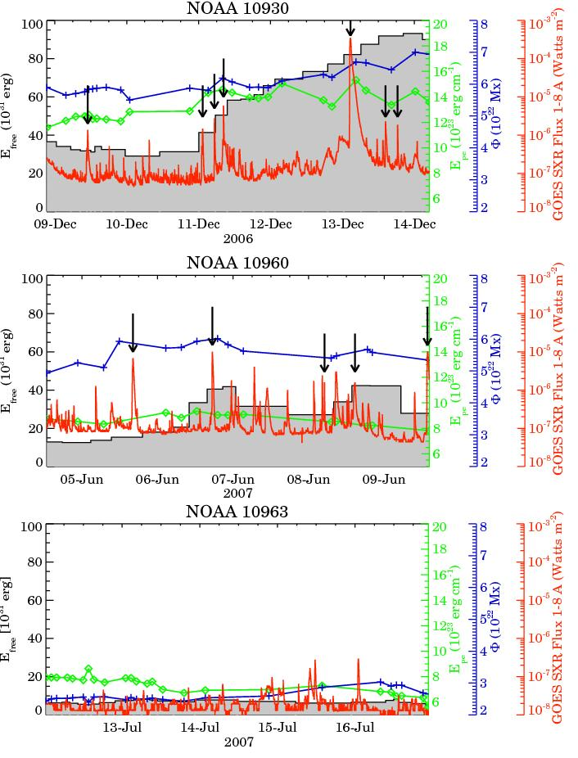
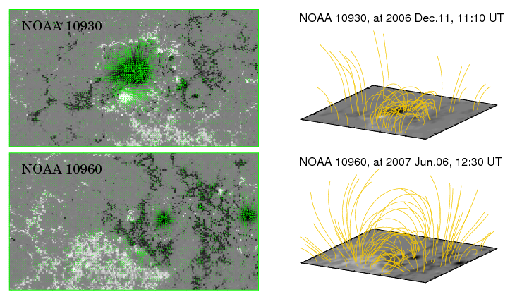
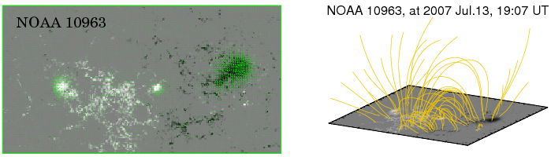
Result #2
Left panels: Snapshots of SOT-SP vector magnetograms of NOAA 10930,10960 and 10963.
Right panels: Extrapolated NLFF fields of NOAA 10930, 10960 and 10963.
Temporal variation of E_{free}, E_{pe}, Φand the GOES light curves of NOAA 10930, 10960 and 10963.

Slide 8
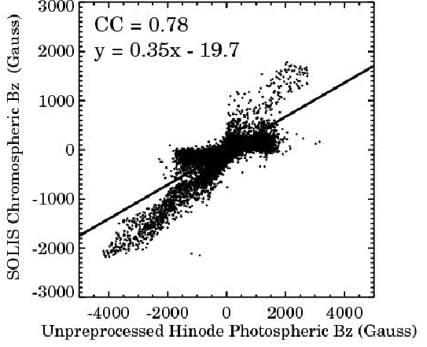
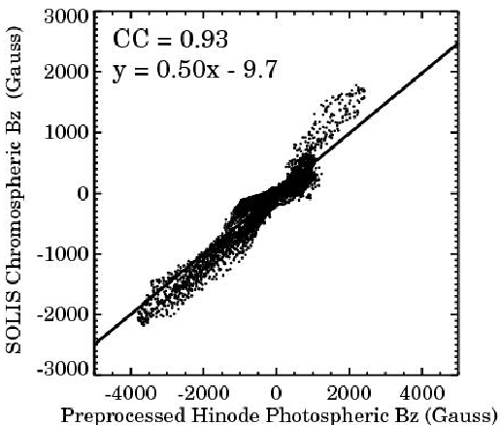
Quality Control #1
Left: SOLIS chromospheric magnetic field Bz vs. unpreprocessed Hinode/SP photospheric Bz;
Right: SOLIS chromospheric Bz vs. preprocessed Hinode/SP photospheric Bz.
The SOLIS chromospheric magnetogram was taken on 2006 Dec.11 at 18:15 UT in AR 10930, and the Hinode/SP photospheric magnetogram was taken at 17:00 UT on the same day and in the same active region.

Slide 9
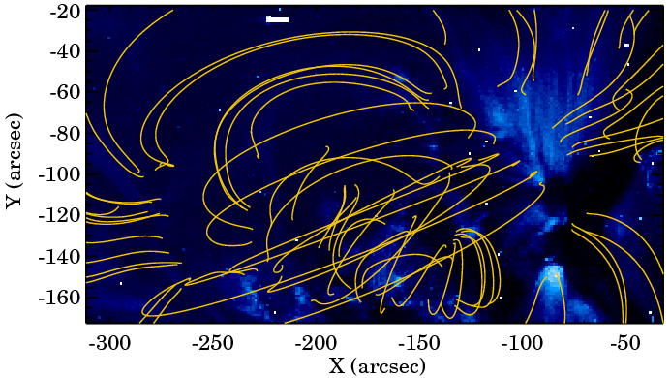
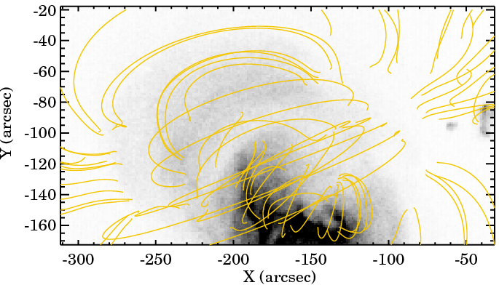
Quality Control #2
Left: TRACE 171 Å image of NOAA 10960, with over-plotted NLFF field lines.
Right: Hinode/XRT image of NOAA 10960, with over-plotted NLFF field lines.
TRACE image: 2007 June 7, 03:10 UT
Hinode/XRT image: 2007 June 7, 03:16 UT
Hinode/SP magnetogram: 2007 June 7, 03:16 UT

Slide 10



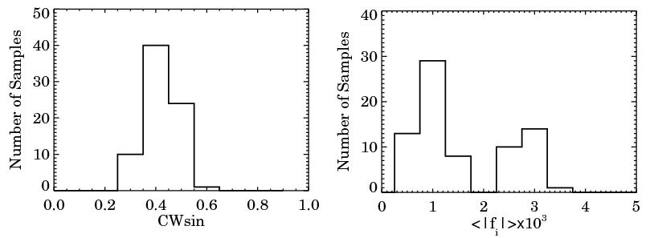
Quality Control #3
where
where is the grid spacing
The histograms of CWsin (left) and <fi>metrics (right) for the 75 samples.

Slide 11
Summary:
1. E_{free} is moderately to strongly correlated with FI_{n-day}. However, compared with photospheric magnetic parameter E_{pe} , E_{free} shows little improvement on the flare predictability.
2. Based on three cases, although the magnitude of E_{free} differentiates between the flare-active and flare-quiet regions, the temporal variation of E_{free} does not exhibit a clear and consistent pre-flare pattern.

Slide 12
Discussion:
Problems in NLFF field modeling from the photospheric boundary
  uncertainties in the transverse field measurements
  ⎯ 180° ambiguity in the transverse field
  the non-force-free nature of the photospheric boundary
  difficulties of guaranteeing the existence and uniqueness of the NLFF field solution
Flare triggering and release mechanisms
  Triggering mechanism?
  Released energy
Thermal emission, as quantified by FI
Non-thermal emission
CME dynamics

