Slide 1
Evolution of Magnetic Setting in Flare Productive Active Regions
Yixuan Li
Space Weather Research Lab
New Jersey Institute of Technology

Slide 2
Introduction
In recent years, it has been widely reported that photosphere magnetic fields can experience some rapid, significant and permanent changes during X-and M-class flares.
Wang et al. (2002) detected a permanent increase in the magnetic flux of the leading polarity and a decrease of smaller magnitude in the following polarity.
Sudol and Harvey (2005) conducted a survey of 15 X-class flares, and found that abrupt and persistent changes in the photospheric longitudinal magnetic fields are common features associated with X-class flares.

Slide 3
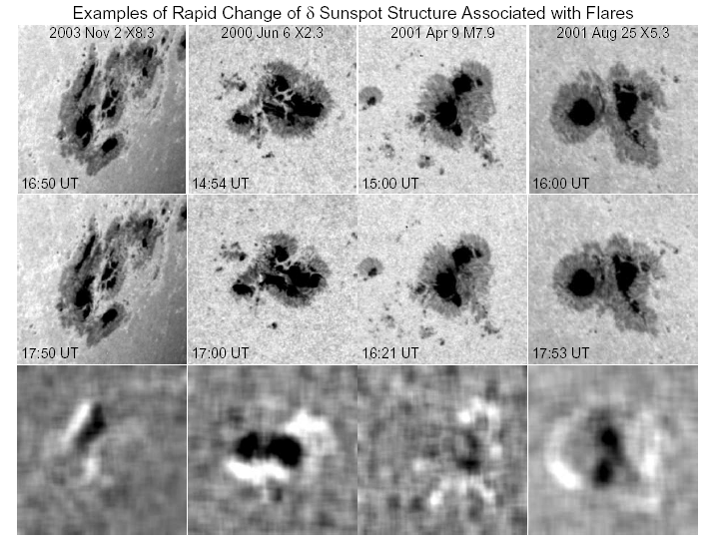
Introduction (Cont.)
Recent white-light (WL) observations demonstrated a consistent pattern of changes in sunspot structures (Wang et al. 2004; Deng et al. 2005; Liu et al. 2005; Chen et al. 2007).
The figure is from Liu et al. (2005)

Slide 4
Change of Magnetic Inclination Angle associated with three major flares
Dec. 13 2006 X3.4 Flare
Notes:
We use the Hinode vector magnetograms taken before and after the X3.4 flare to study the changes in magnetic inclination angle. This event occurred in NOAA active region 10930, with the peak GOES soft X-ray emission at 2:40 UT on 2006 December 13. We obtained the difference image, postflare minus preflare state in Hinode G-band. This figure compares the sunspot structures before and after the flare. The brightened and darkened areas in the difference image represent the penumbral decayed and enhanced regions with G-band intensity. In the right column, the evolution of the mean G-band intensity of decayed and enhanced regions were shown.

Slide 5
Change of Magnetic Inclination Angle associated with three major flares (Cont.) ⎯ Distribution of Magnetic Inclination Angle and Transverse Field Strength
Decay Regions
Enhance Region
Notes:
We compare the pre-flare and the post-flare distributions of several parameters. Here shows the change of magnetic inclination angle and the transverse field strength. The mean values of parameters before and after the flare are indicated by the vertical green and orange lines, respectively. Evidently, we can see that the inclination angle increases by ~3.3 degree after the flare in the decayed region, and decreases by 5 degree in the enhanced region.

Slide 6
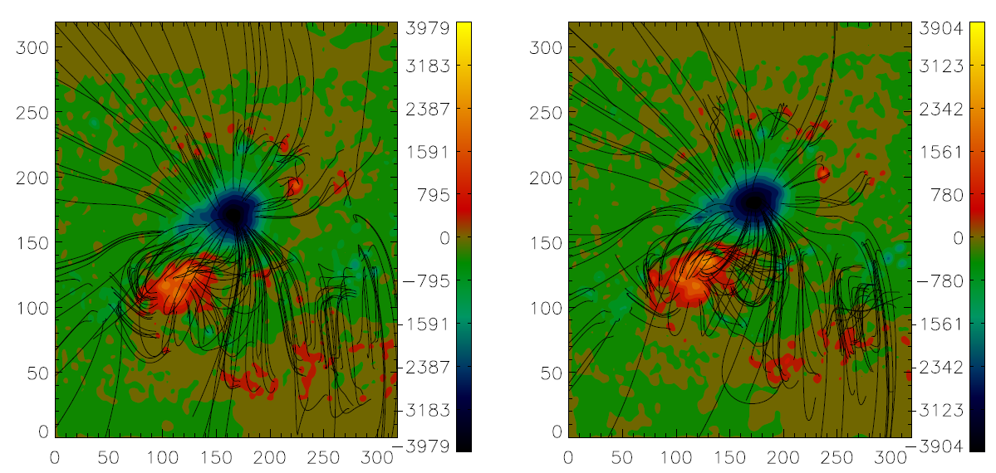
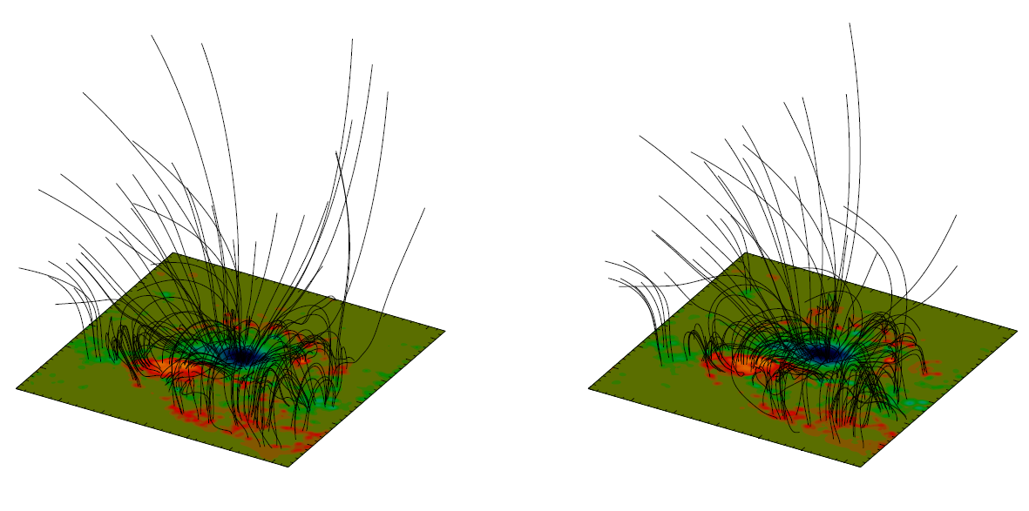
Change of Magnetic Inclination Angle associated with three major flares (Cont.) ⎯3-D NLFF Fields

Slide 7
Change of Magnetic Inclination Angle associated with three major flares (Cont.) ⎯The Height Variation
Using the 3-D NLFF fields, we plot the mean value of magnetic inclination angle in the decayed (top) and enhanced
(bottom) areas as a function of altitude for two time bins. Blue: Before the flare. Red: After the flare.
Notes:
Using the 3-D NLFF fields, we plot the magnetic inclination angle in the decayed and the enhanced regions as a function of altitude. We see that from the photosphere boundary to an altitude of ~40 Mm, the magnetic inclination angle in the decayed region increases after the flare, while in the enhanced region, the angle decreases in all level of altitudes. Beyond ~70 Mm, the field of both decayed and enhanced regions approach potential.

Slide 8
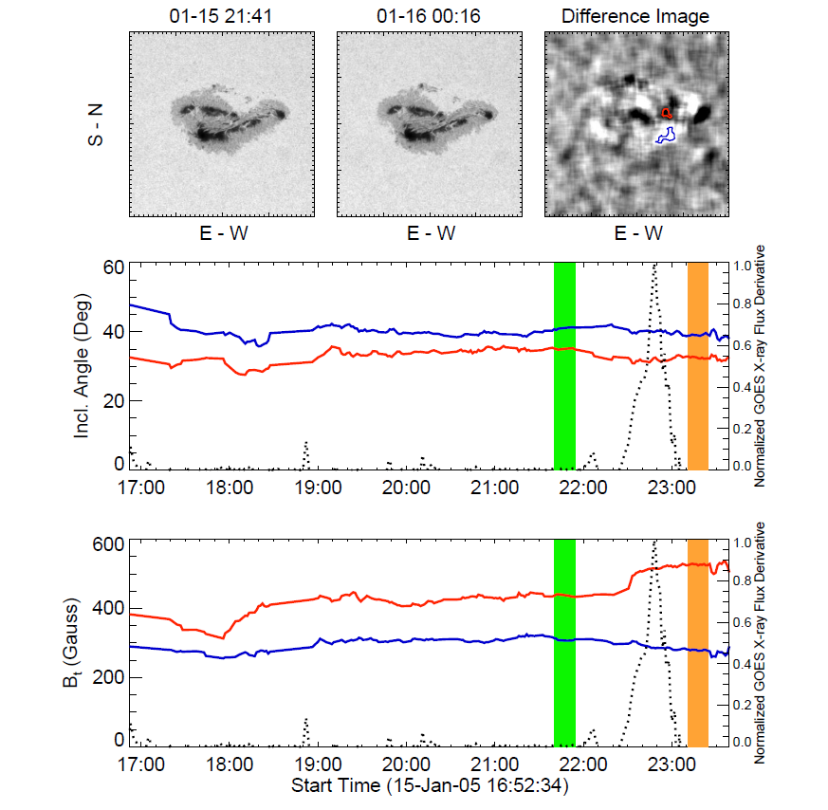
Change of Magnetic Inclination Angle associated with three major flares (Cont.) ⎯Temporal Variation
Jan. 15 2005 X2.6 Flare
Aug. 25 2001 X5.3 Flare
Left Top: TRACE WL images. The FOV is 160"×180". Left Middle & Bottom: The time variation of the mean magnetic inclination angle and transverse field in decayed area (blue) and enhanced area (red). The dotted curve is the time derivative of GOES X-ray flux. The vertical green and orange lines indicate the time ranges chosen to calculate the mean values before and after the flares. Right: same as left, except that the FOV of TRACE WL images is 300"×300".
Notes:
Previous event shows the trend of magnetic inclination change. But to demonstrate that this change are caused by flares, we need to use the high cadence vector magnetogram and to show the temporal evolution of the magnetic inclination angles associated with flares. we studied other two events that occurred on 2001 Aug. 25 and 2005 Jan. 15. The difference images were obtained with TRACE WL observation. To line the temporal evolution of the flares, we superposed the derivative of the soft X-ray light curve onto the time profiles. For the X5.3 flare event, the magnetic inclination angle changes start as the flare occurred, and achieve the maximum change rate on both outer penumbral decayed and inner penumbral enhanced regions, which shows the similar evolutional trend as the X3.4 flare. For the X2.6 flare event, there are several bright and dark areas presented in the WL difference image. However, not all the bright and dark regions indicate the penumbral decaying or the umbral darkening. Some motions of features may affect the difference image as well. Therefore using the time-lapse WL movie, we figure out the exact location of the decayed and enhanced regions. The magnetic inclination angle on the decayed regions in this event increases gradually after the flare, while on the enhanced region, the trend of the change is similar as the other two events.

Slide 9
Change of Magnetic Inclination Angle associated with three major flares (Cont.) ⎯ The Change of Different Parameters
Parameters |  | Magnetic Inclination Angle θ (Degree) | Transverse Field Strength B_{t} (Gauss) | Continuum Intensity I (DN) | Doppler Width² W (mA²) | Filling Factor f
2006 Dec.13 X3.4 Event | Decayed Regions | ↑~ 3.3º | ↓~ 16% | ↑~ 4% | Barely change | ↓~ 15%
 | Enhanced Regions | ↓~ 5º | ↑~ 20% | ↓~ 7% | ↑~ 9% | ↑~ 10%
2001 Aug. 25 X5.3 Event | Decayed Regions | ↑~ 5º | ↓~ 17%
 | Enhanced Regions | ↓~ 4.8º | ↑~ 15%
2005 Jan. 15 X2.6 Event | Decayed Regions | ↓~ 1.8º | ↓~ 10%
 | Enhanced Regions | ↓~ 2.7º | ↑~ 21%
Notes:
This table summarizes the change or change rate of different parameters. For the X3.4 flare on 2006 Dec.13, the mean magnetic inclination angle in the decayed peripheral penumbral increased by 3.3 degrees after the flare, indicating that the magnetic field in this area became more vertical. Meanwhile, the mean value of magnetic inclination angle in the central area close to flaring neutral line decreased by 5 degrees, meaning that the magnetic fields in this area became more horizontal. For the X5.3 flare event, we find that the magnetic inclination angle in the penumbral decayed region increased about 9 degrees after the flare, while that in the umbral enhanced region decreased by about 4 degrees. Compared with these two events, the mean magnetic inclination angle on the decayed regions in the X2.6 flare event drop 1.8 degrees.
These results support the reconnection picture proposed by Liu et al. There are two separate magnetic systems in a delta-sunspot before the flare, after the flare these two become strongly connected. The higher reconnected field lines stretched the outside penumbral which account for the penumbral decay. Meanwhile, the low field line near NL become more horizontal that can explain the darkening of central umbral regions. In this case, the observed penumbral decay is a signature of a change in the magnetic configuration from a more inclined to a more vertical one as a projected onto a 2-D image.

Slide 10
Data Sources for Current and Future Research
Instrument | Temporal Resolution | Pixel Resolution | FOV | Time Coverage
Hinode/SOT/SP¹ | Normally A few hours | 0.16" | 300"×160" | From Sep. 2006
SDO/HMI² | 12 minutes | 1" | Full disk | Later this year
BBSO/DVMG³ | 1 min | 0.6" | 360"×360" | From 1999
¹ Hinode/Solar Optical Telescope (SOT) / Spectral-polarimeter (SP)
²Solar Dynamics Observatory (SDO) / Helioseismic and Magnetic Imager (HMI)
³ BBSO (Big Bear Solar Observatory) / Digital Vector Magnetograph (DVMG)

Slide 11
Comparison of Observational Results and Flare/CME Models
Yuhong Fan’s recent simulation

Slide 12
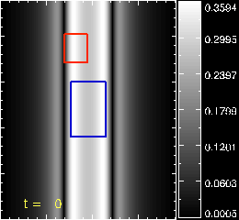
Comparison of Observational Results and Flare/CME Models (Cont.)
Level 5
transverse field B_{t}

Slide 13
Comparison of Observational Results and Flare/CME Models (Cont.)
Level 1
Level 10
Level 100

Slide 14
Comparison of Observational Results and Flare/CME Models (Cont.)
Ben Lynch from SSL in UC Berkeley has another simulation based on the Break-out flare model.

Slide 15
Conclusion
After the flare, the mean inclination angle at the inner penumbral/umbra enhanced regions decreases. The result suggests that inner penumbral fields change from a more vertical to a more inclined configuration after the flare.
We quantitatively compare our observations with recent MHD simulations of eruption, which shows the evidence of field lines turn to more horizontal near the surface, immediately following the eruption.

